Slide 1
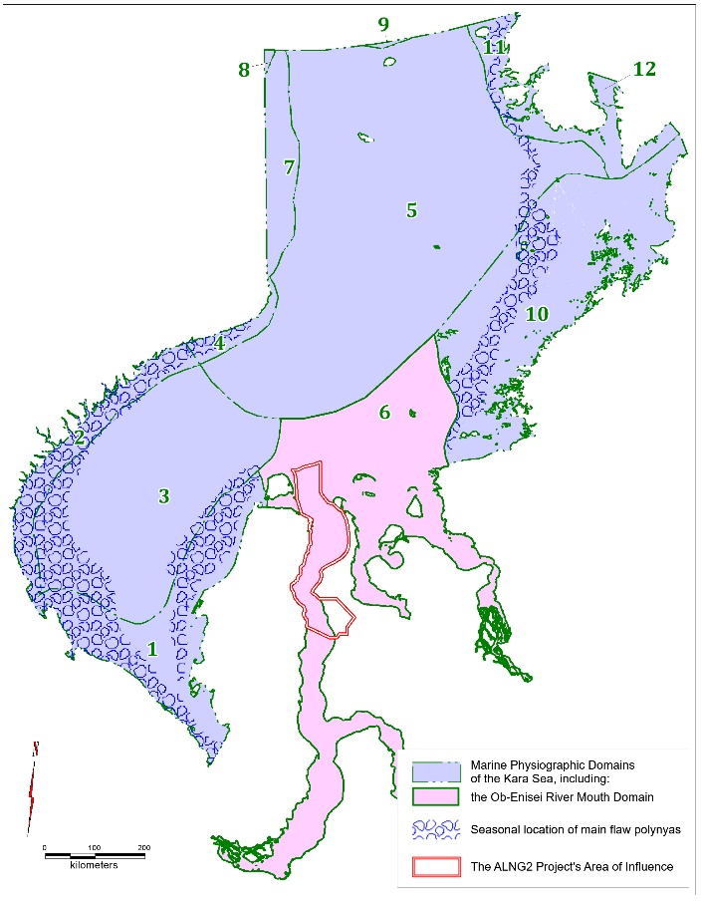
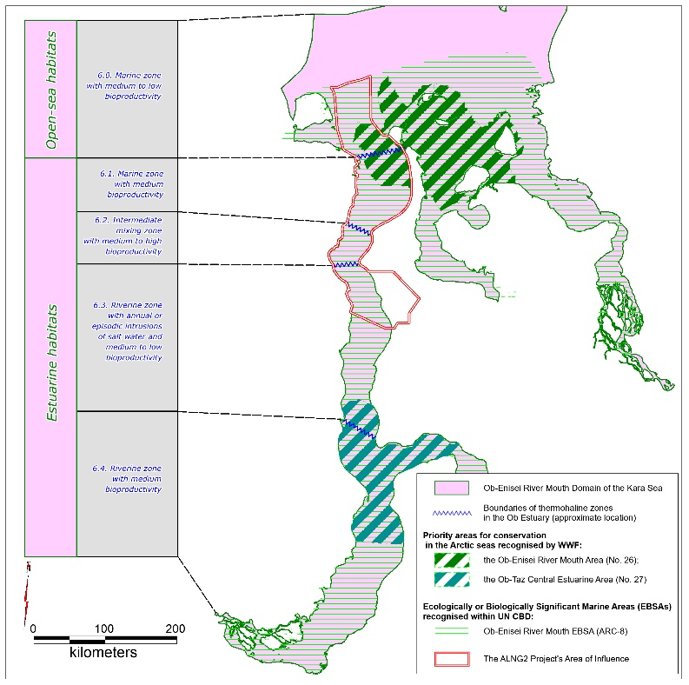
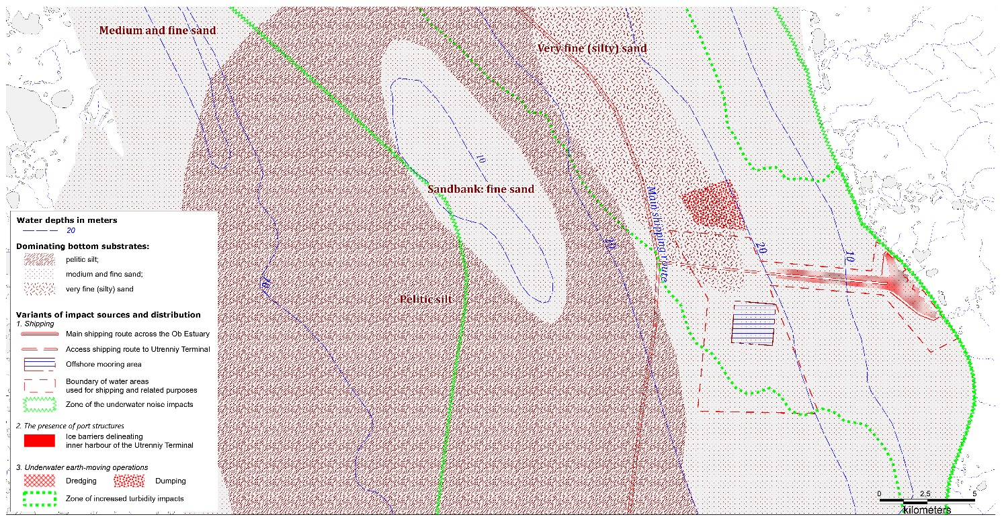
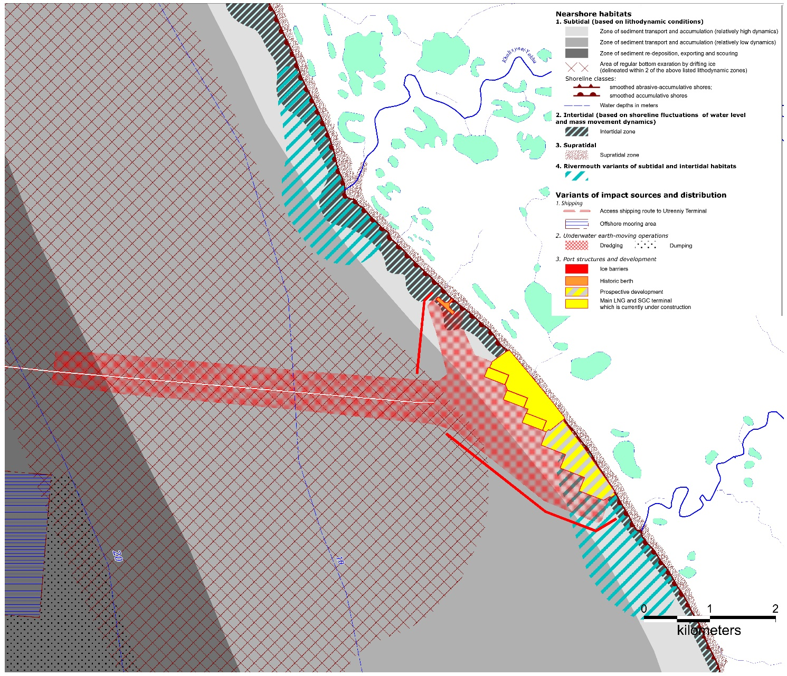
Level 1 ― Marine Physiographic Domains
Level 2 ― Ob Estuarine Mixing Zones within Domain 6 the Kara Sea (6)
Level 3 ― Estuarine Habitats Differing in Terms of Bathymetry and Bottom Sediment Conditions (within Zone 6.3 of the Ob estuarine seascape)
Level 4 ― Nearshore Local Habitats Differing in Terms of Tidal activity, Lithodynamics and Sediment and Freshwater Inputs from Rivers (within the Habitat 6.3.1)

